Slide 1



Store sales forecasting
Data Science Graduation Project

Slide 2




MEET OUR TEAM
Nasir Abu-Own
Mohammed Al-Mansi
Abbad Zayed
Ultimate Nasir Abu-Own

Slide 3
CONTENTS
Problem Statement
Data Preprocessing
Feature Importance And Selection
Model Selection
Hypermeter Tuning
Error Analysis
Deployment

Slide 4
Problem Statement
4
We have 45 stores with a different number of departments. We built two models one for the weekly sales for each department in a store, and another one for the whole store

Slide 5
Data preprocessing
Encoding (One hot ,Category):
We used one hot to encode the store types to get three distinct features, and we used category to encode the departments of the stores.
Data merging and cleaning:
We merged the datasets in different ways to create the two models, and cleaned the NAN data and transformed some of the data types.

Slide 6
Feature importance and selection
Permutation importance:
We used ELI5 after fitting the XGB model to know the weights of each Feature in our dataset and then we took the highest features to use it in our model.

Slide 7
Model selection
We used three different models (decision tree regressor, SVR , and Random Forest Regressor) :
Decision Tree Regressor:
We had overfitting since the trained score was 0.97 while the testing score was 0.88.
SVR:
We had underfitting the testing and training score were under 0.5.
Random Forest Regressor:
While it was not the most efficient it gave us an accuracy score around 0.95 for both models .

Slide 8
Hypermeter Tuning
Randomized Search CV:
We used it on our first model, because its good for testing a wide range of values and normally reaches good combinations relatively fast.
Grid Search CV:
We used it because the data frame became smaller and we can test all combinations and gave us the best hyper parameters.

Slide 9

Percentage error Law
$Error \%= \frac{Predicted value−Actual value }{Actual value}∗100\%$

Slide 10
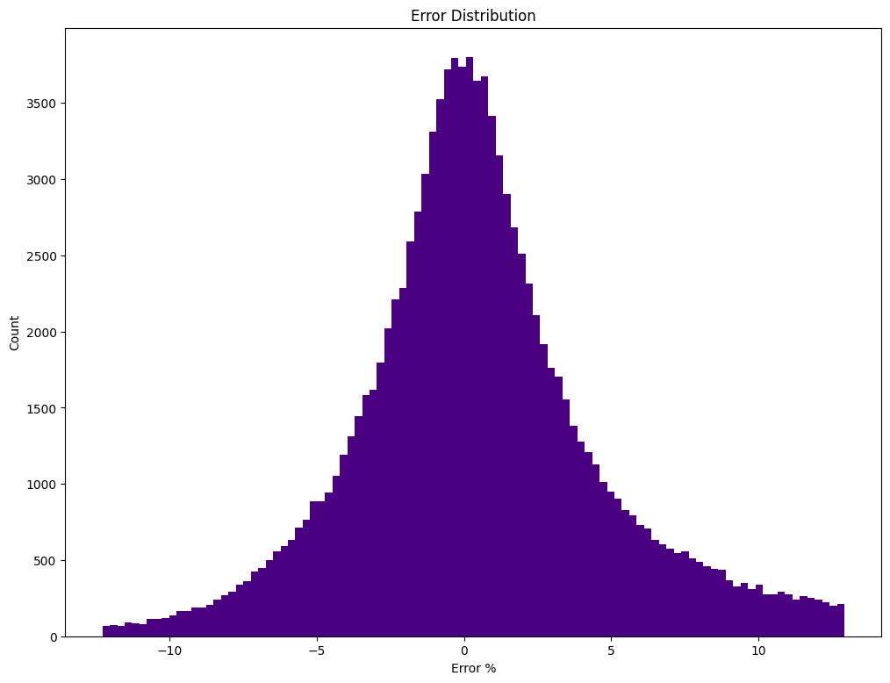
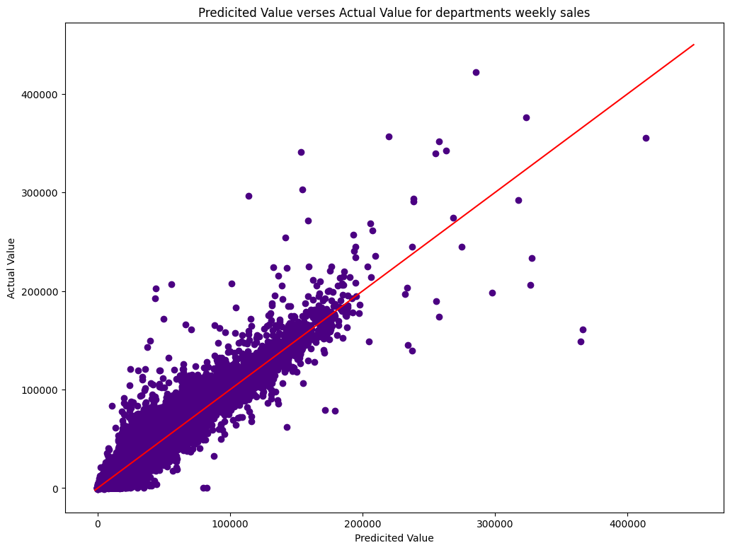
Error analysis for department
Error Distribution
Scatter for predicted and actual

Slide 11
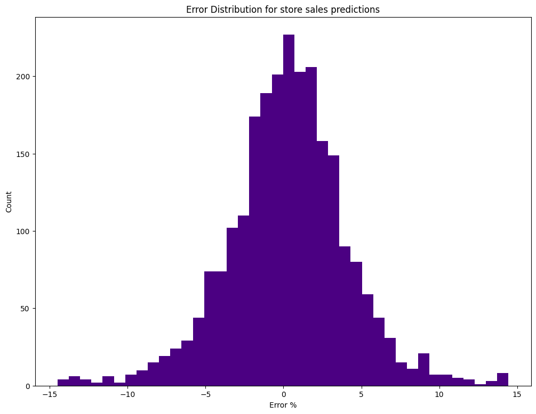
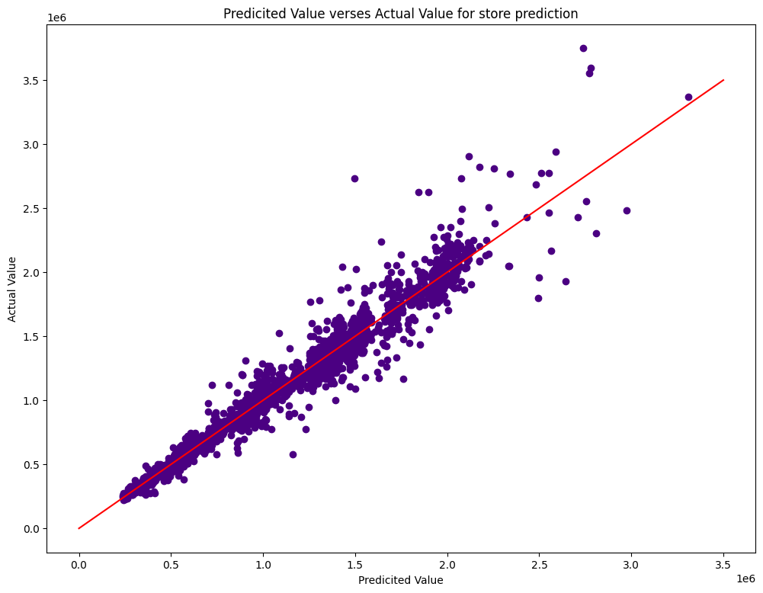
Error analysis for Stores
Error distribution
Scatter for predicted and actual

Slide 12
Deployment
WE deployed our two predictive models into one web page using stream lit.
The first model predicts the weekly sales for a department in a store.
The second model predicts the weekly sales for a whole store.

Slide 13
THANK YOU
Orange Coding Academy
Coach Deena Al-Abed
Coach Aya Miqdadi
Coach Osama Refaie
Coach Aadi Gupta

